Slide 1
SPL-1 Presentation
Topic: Matrix Factorization
Presented by:
Ahnaf Mubashshir Mobin
BSSE-1232

Slide 2
What is matrix factorization?
A process by which a matrix is factorized into two different matrices in such a way that after multiplication them we get the parent matrix.
?? | ??
?? | ??
?? | ??
?? | ??
a | b | c
d | e | f
g | h | i
j | k | l
(4*2)
?? | ?? | ??
?? | ?? | ??
(2*3)
(4*3)

Slide 3
Project Description
Addition of matrices
Subtraction of matrices
Multiplication of two matrices
Transpose matrix
Pseudo inverse of a matrix
Matrix normalization
Error Calculation
Multiplicative Update
Hadamard initialization

Slide 4
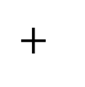
Addition of two matrices
Element-wise addition of two matrices.
A_{i,j}= (B_{i,j}) + (C_{i,j})
a | b
c | d
e | f
g | h
i | j
k | l
a+g | b+h
c+i | d+j
e+k | f+l
(3*3)
(3*3)
(3*3)

Slide 5
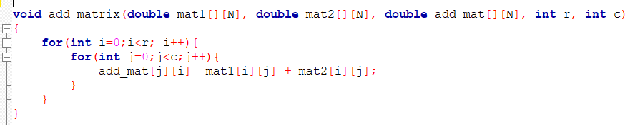
Source code

Slide 6
Subtraction of two matrices
Element-wise subtraction of two matrices.
A_{i,j}= (B_{i,j}) - (C_{i,j})
a | b
c | d
e | f
g | h
i | j
k | l
a-g | b-h
c-i | d-j
e-k | f-l
(3*3)
(3*3)
(3*3)

Slide 7
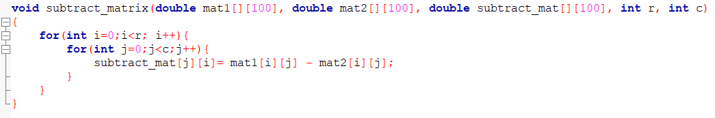
Source code

Slide 8

Multiplication of two Matrices
A_{i,j}= (B_{i,k}) x (C_{k,j}) + (A_{i,k}) x (C_{k,j}) + (A_{i,k}) x (C_{k,j})
a | b | c
d | e | f
g | h
i | j
k | l
ag+bi+ck | ah+bj+cl
dg+ei+fk | dh+ej+fl
(2*3)
(3*2)
(2*2)

Slide 9
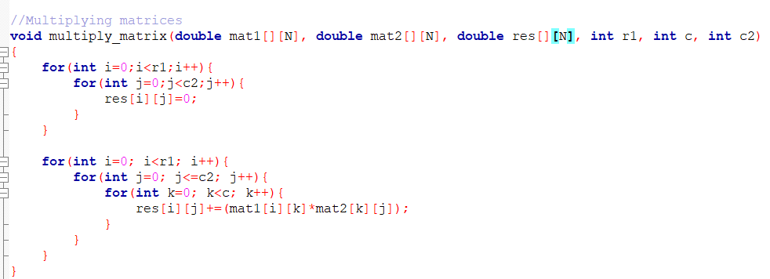
Source code

Slide 10
Transpose matrix
Transforming the row into columns and columns into rows.
a | b
c | d
e | f
A_{i,j}= A_{j,i}
a | c | e
b | d | f
(2*3)
(3*2)

Slide 11
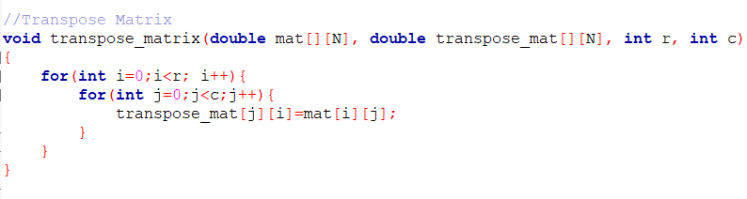
Source code

Slide 12
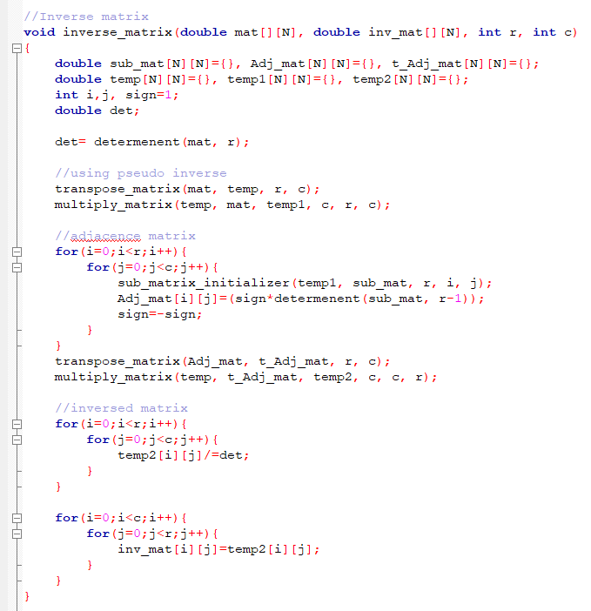
Pseudo inverse of a matrix
A matrix inverse-like object that may be defined for a complex matrix, even if it is not necessarily square
A⁺=(A^{T}xA)⁻¹xA^{T}

Slide 13
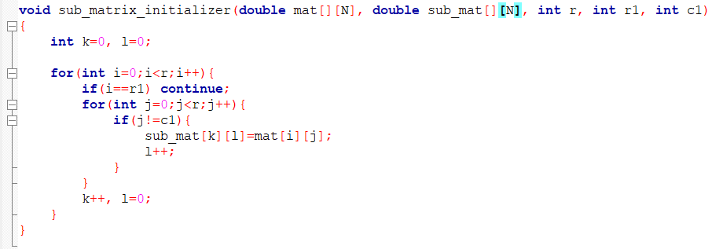
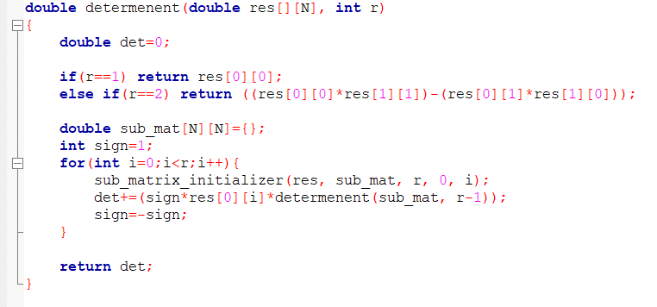
Source code
Determinant function
Finds the determinant of any matrix even its a non-square matrix.

Slide 14
Matrix Normalization
Normalizing the matrix by dividing every elements by Standard Deviation(SD).
$$σ(SD)=\sqrt{\frac{\sum{x_{i}{(−μ)}_{2}}}{N}}$$
$$A_{i,j}=\frac{A_{i,j}}{σ}$$
14 | 15 | 34
54 | 12 | 55
23 | 2 | 40
0.88 | 0.94 | 2.14
3.40 | 0.75 | 3.46
1.44 | 1.26 | 2.51

Slide 15
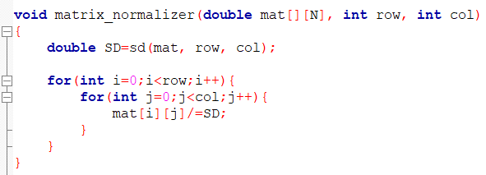
Source code

Slide 16
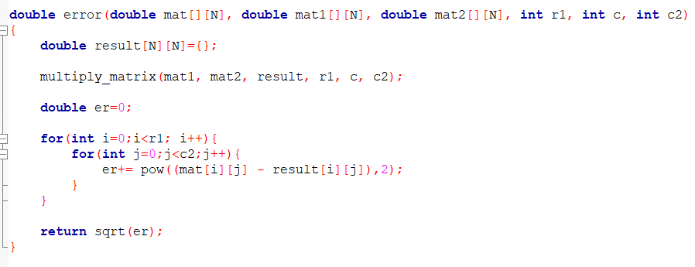
Error Calculation
Calculates element-wise error using . (Frobenius norm)
error=$\sqrt{\sum{\text{\{}\text{Ai}\text{,}\text{j}\text{ − (}\text{Ai}\text{,}\text{jx} \text{Bi}\text{,}\text{j}\text{)\}}\text{2}}}$

Slide 17

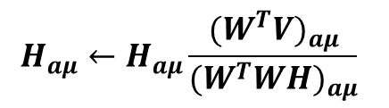



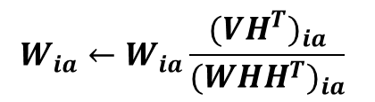
Multiplicative update
Let, V=WH where V is the initial matrix and W and H be the factorized matrix. The multiplicative update is ran using the given equation.
H$←H+{\text{η}}_{H}∙(W^{T}X −W^{T}WH)$
W$←W+{\text{η}}_{W}∙({XH}^{T} −{WHH}^{T})$
$$↓$$
$$↓$$
$$H_{aμ}←H_{aμ}\frac{{(W^{T}V)}_{aμ}}{{(W^{T}WH)}_{aμ}}$$
$$W_{ia}←W_{ia}\frac{{({VH}^{T})}_{ia}}{{({WHH}^{T})}_{ia}}$$
Here one matrix is kept constant and another one is changed as we try to get closer to the final value.

Slide 18
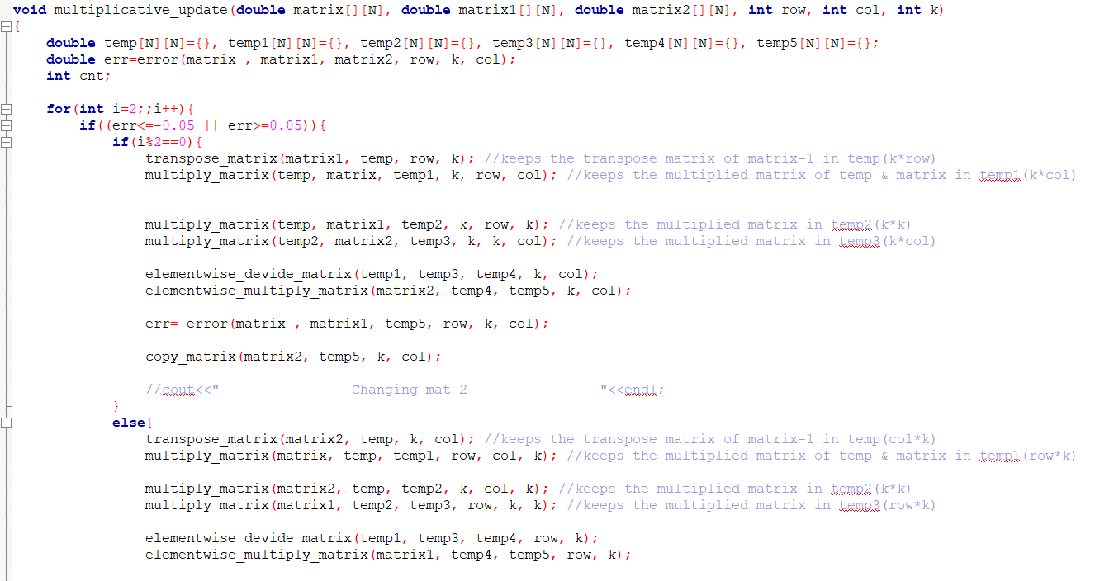
Source code

Slide 19
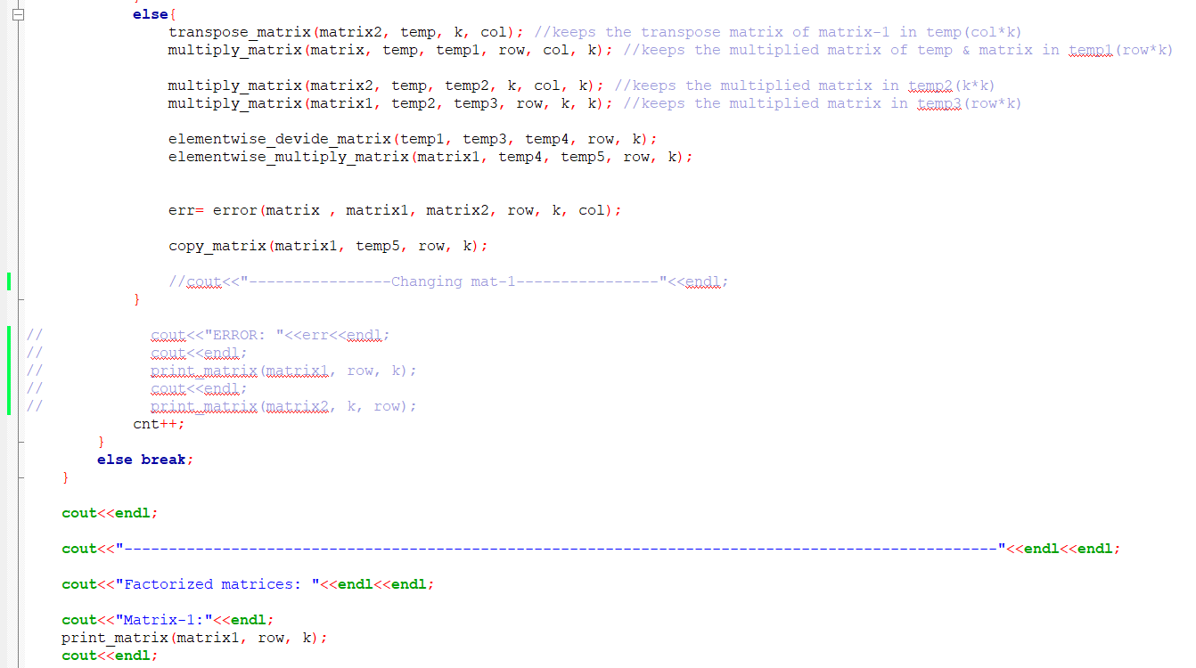
Source code

Slide 20
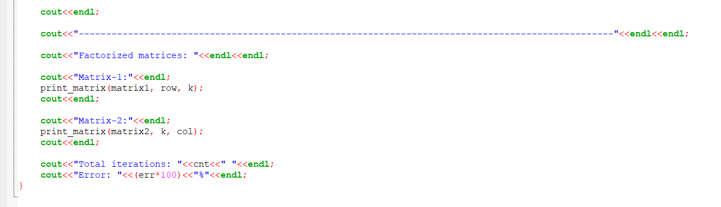
Source code

Slide 21
Thank You

